Slide 1
Automated Classification of Pigmented Skin Lesions Using Deep Learning
Pattern Recognition and Machine Learning / 2025/ Q2 - Assessment 3
By Ruhan Shafi

Slide 2
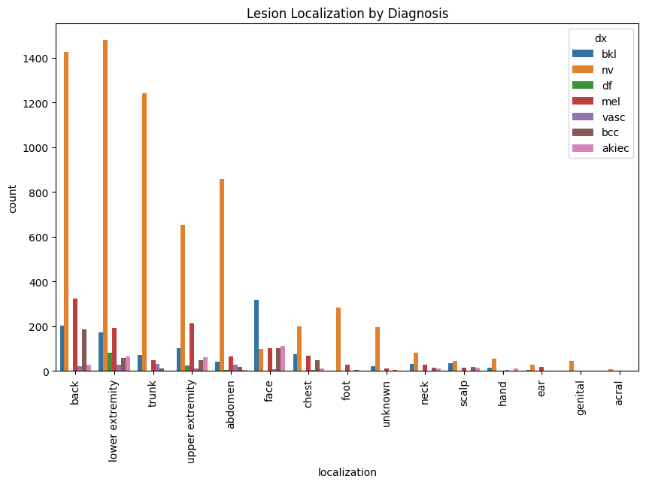
Background & Motivation
Melanoma is one of the most aggressive skin cancers, making early detection vital for effective treatment.
Why is the problem that this project focuses on?
Traditional diagnostic processes rely heavily on visual inspection, leading to potential errors due to human subjectivity.
Deep learning provides a scalable solution, capable of learning complex visual patterns from thousands of images such as those found within the HAM10000 Dataset.
Problems are significant class imbalance, as some categories dominate the dataset & visual similarities between lesion types
The motivation behind this project is to leverage PRML techniques to overcome these challenges and enhance diagnostic accuracy

Slide 3
Methodology & Computational Approach
A comparative design was adopted between CNN and MLP architectures to evaluate performance differences.
How to approach the way to achieve the goals of this project
The CNN was chosen for its capacity to learn hierarchical spatial patterns inherent in medical imaging.
The MLP, serving as a baseline, provided insight into the importance of spatial feature extraction.
Preprocessing included image resizing and normalization to standardize input across models.
Data augmentation (rotation, flipping, zooming) was applied to increase sample diversity and mitigate overfitting.
Bayesian optimization was used for hyperparameter tuning, balancing accuracy and efficiency by prioritising promising configurations.
TensorFlow served as the primary framework due to its GPU support and integration with Keras Tuner TensorBoard for Hypertuning with performance tracking.

Slide 4
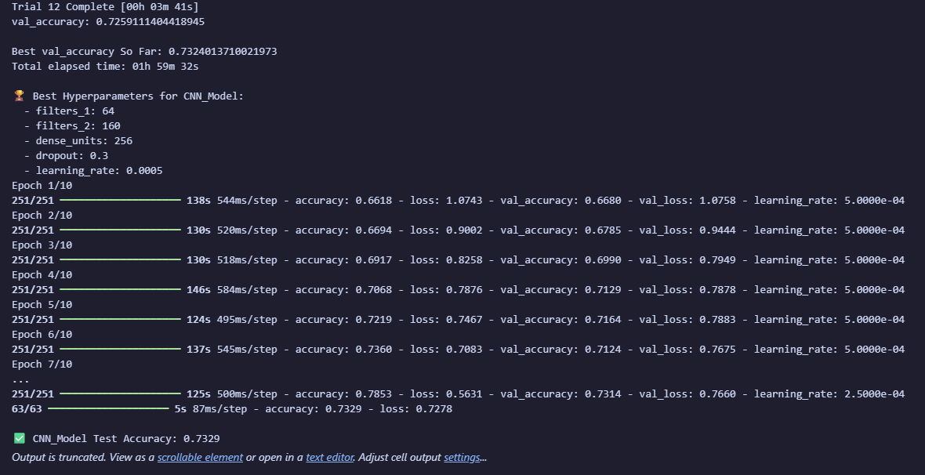
Hyperparameter Tuning & Implementation
The tuning framework systematically explored hyperparameters such as learning rate, dropout, and filter size through the use of Bayesian Optimization which narrowed the search space using probabilistic models.
Refining the model
ReduceLROnPlateau dynamically adjusted the learning rate, enabling smoother convergence.
The tuning process included EarlyStopping to prevent overfitting by halting training once validation loss plateaued.
Once optimal hyperparameters were identified, the model was retrained from scratch on the entire training dataset.
This retraining phase aimed to maximise learning stability and ensure robust generalisation before final evaluation on unseen data.

Slide 5
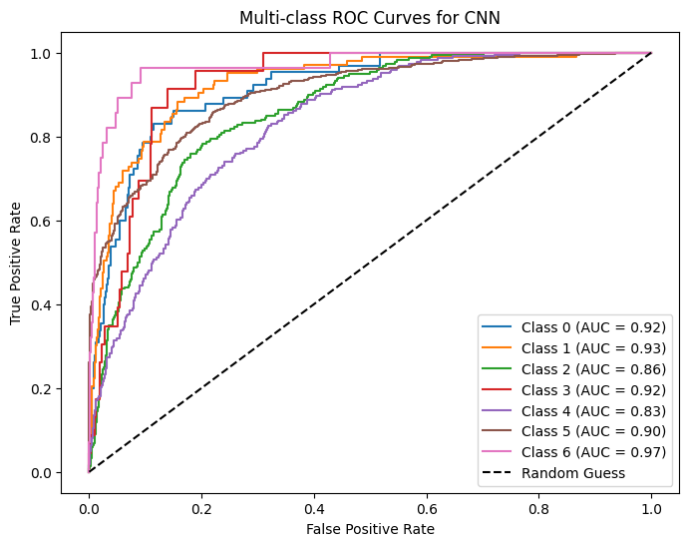
Evaluation Harness & Performance during Hyperparameter Search
The evaluation harness incorporated multiple metrics to assess both global and class-level performance.
Evaluating on the Accuracy of the Model
Confusion matrices identified areas where the model struggled, particularly between melanoma and nevi.
ROC curves revealed high AUC scores across most classes, indicating strong separability.
Learning curves showed steady improvement and early convergence without significant overfitting.
The CNN consistently outperformed the MLP in validation accuracy and generalisation capability.
Overall, the results demonstrate that CNNs effectively capture fine-grained spatial details critical for lesion classification.

Slide 6
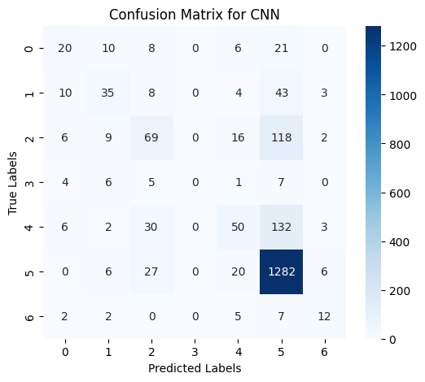
Training Final Model & Predictions on Unseen Data
The final CNN model was evaluated on unseen data to assess true generalisation performance.
Journey’s End
Predictions were visualised to verify consistency between true and predicted labels.
Probability heatmaps highlighted the model’s confidence in correct classifications.
High confidence correlated strongly with accurate predictions, reflecting model reliability.
The model showed resilience to background noise and lighting variations, typical of real-world clinical imagery.
Minor misclassifications were primarily observed in visually similar lesion pairs.
These findings affirm that the trained CNN can effectively generalize to new, unseen samples, a key criterion for clinical applicability.

